Slide 1

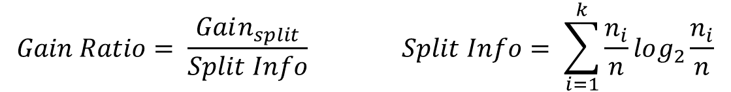
Gain Ratio
Gain Ratio:
Parent Node, $p$ is split into $k$ partitions (children)
$n_{i}$ is number of records in child node $i$
$$Gain Ratio= \frac{Gain_{split}}{Split Info} Split Info= \sum_{i=1}^{k}{\frac{n_{i}}{n}log_{2}}\frac{n_{i}}{n}$$
SplitINFO = 1.52
SplitINFO = 0.72
SplitINFO = 0.97

Slide 2
Gain Ratio
k = 3
4/20log2(4/20)+8/20log2(8/20)+8/20log2(8/20)
Split info = 1.52
k = 2
16/20log2(16/20) + 4/20log2(4/20)
0.72

Slide 3
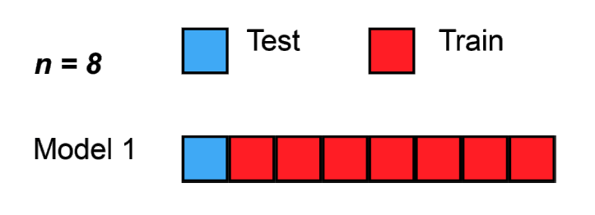
Cross-Validation

Slide 4
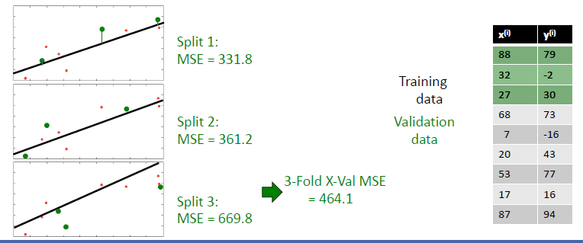
Simpler Model

Slide 5
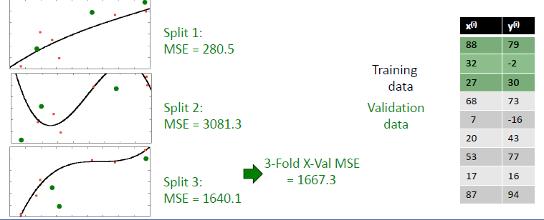
Complex Model

Slide 6
Data Mining Classification: Alternative Techniques
Bayesian Classifiers
Week3 Lecture

Slide 7
Uncertainty in the world
Uncertainty due to
Randomness
Overwhelming complexity
Lack of knowledge

Slide 8
Examples
Spam Email Filtering: Classifies emails as spam or non-spam based on features.
Text Classification: Used in sentiment analysis, document categorization, and topic classification.
Medical Diagnosis: Helps in predicting the likelihood of a disease based on symptoms.

Slide 9
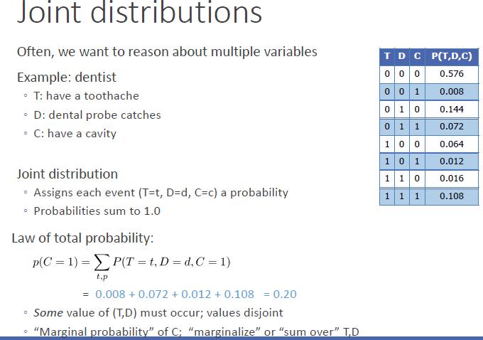
Joint Distributions

Slide 10
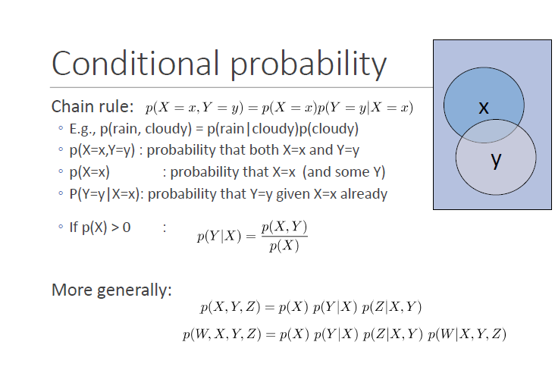
Conditional Probability

Slide 11
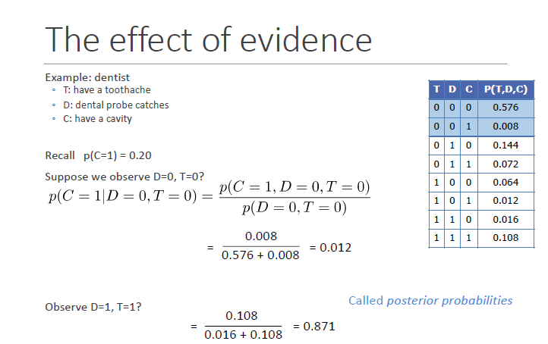
Example of Conditional Probability

Slide 12
Bayes Classifier
Let X denote the attribute set and Y denotes the class variable. If the class variable has a non-deterministic relationship with the attributes, then we can treat X and Y as random variables and capture their relationship probabilistically using P(Y |X).
This conditional probability is also known as the posterior probability for P(Y/X) , as opposed to its prior probability, P(Y ).

Slide 13
Bayes Classifier
During the training phase, we need to learn the posterior probabilities P(Y |X) for every combination of X and Y based on information gathered from the training data. By knowing these probabilities, a test record X can be classified by finding the class Y that maximizes the posterior probability

Slide 14
Bayes Classifier
A probabilistic framework for solving classification problems
Conditional Probability:
Bayes theorem:

Slide 15
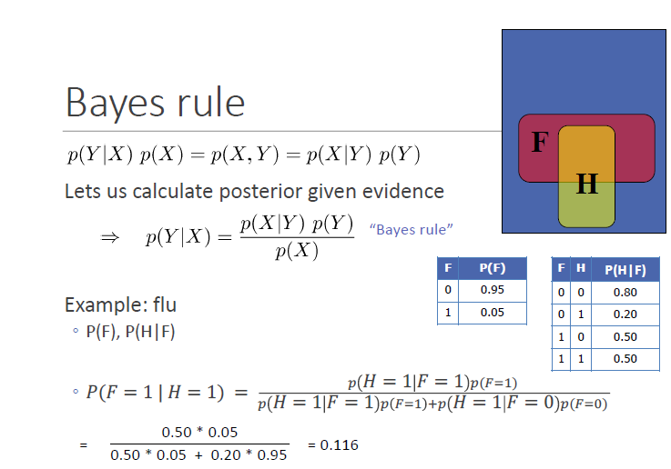
Example

Slide 16
Example
Consider a football game between two rival teams: Team 0 and Team 1.
Suppose Team 0 wins 65% of the time and Team 1 wins the remaining
matches. Among the games won by Team 0, only 30% of them come
from playing on Team 1’s football field. On the other hand, 75% of the
victories for Team 1 are obtained while playing at home. If Team 1 is to
host the next match between the two teams, which team will most likely
emerge as the winner?

Slide 17
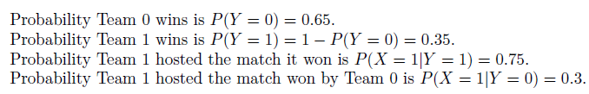
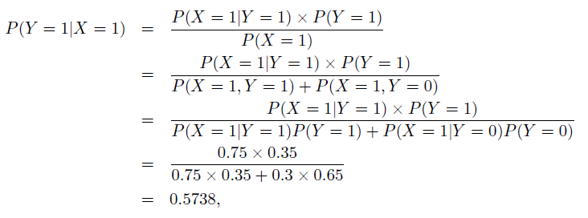
Solution

Slide 18
Using Bayes Theorem for Classification
Consider each attribute and class label as random variables
Given a record with attributes (X₁, X₂,…, X_{d}), the goal is to predict class Y
Specifically, we want to find the value of Y that maximizes P(Y| X₁, X₂,…, X_{d} )
Can we estimate P(Y| X₁, X₂,…, X_{d} ) directly from data?

Slide 19
Using Bayes Theorem for Classification
Approach:
compute posterior probability P(Y | X₁, X₂, …, X_{d}) using the Bayes theorem
Maximum a-posteriori: Choose Y that maximizes P(Y | X₁, X₂, …, X_{d})
Equivalent to choosing value of Y that maximizes P(X₁, X₂, …, X_{d}|Y) P(Y)
How to estimate P(X₁, X₂, …, X_{d} | Y )?

Slide 20
Example Data
Given a Test Record:
We need to estimate
P(Evade = Yes | X) and P(Evade = No | X)
In the following we will replace
Evade = Yes by Yes, and
Evade = No by No

Slide 21
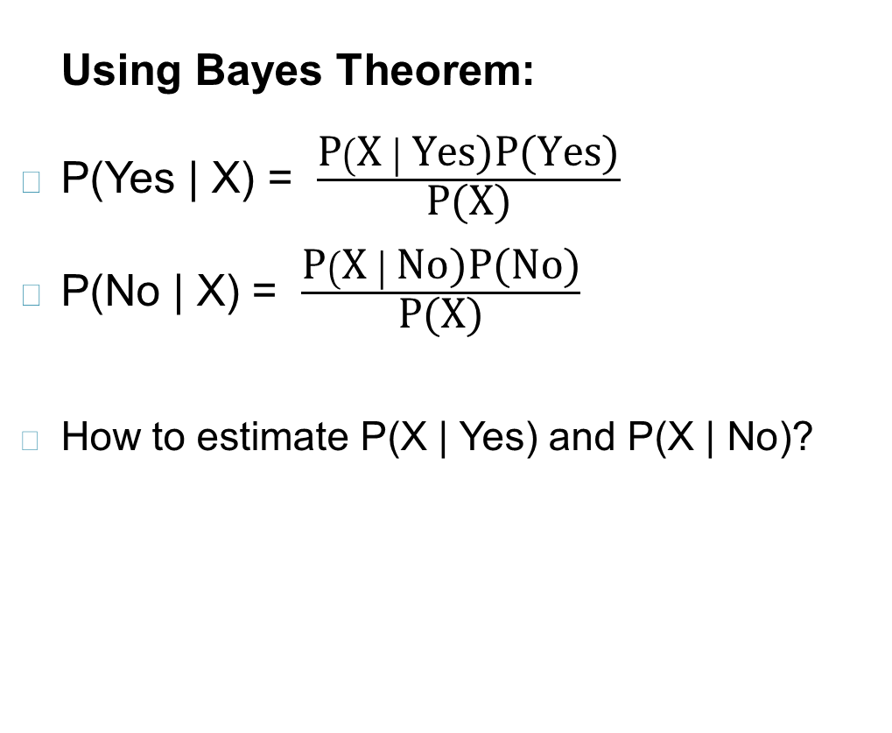
Example Data
Given a Test Record:
Notes:
We will compare P(Yes/X) and P(No/X)
P(X/Y) is class conditional probability

Slide 22
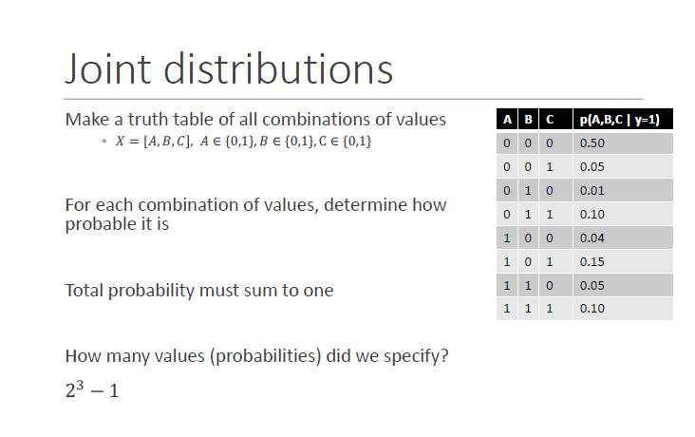
Bayes Classifier Problem

Slide 23
Conditional Independence
X and Y are conditionally independent given Z if P(X|YZ) = P(X|Z)
Example: Arm length and reading skills
Young child has shorter arm length and limited reading skills, compared to adults
If age is fixed, no apparent relationship between arm length and reading skills
Arm length and reading skills are conditionally independent given age

Slide 24
Naïve Bayes Classifier
A naıve Bayes classifier estimates the class-conditional probability by assuming that the attributes are conditionally independent, given the class label y.

Slide 25
Naïve Bayes Classifier
Assume independence among attributes X_{i} when class is given:
P(X₁, X₂, …, X_{d} |Y_{j}) = P(X₁| Y_{j}) P(X₂| Y_{j})… P(X_{d}| Y_{j})
Now we can estimate P(X_{i}| Y_{j}) for all X_{i} and Y_{j} combinations from the training data
New point is classified to Y_{j} if P(Y_{j}) Π P(X_{i}| Y_{j}) is maximal.

Slide 26
Naïve Bayes on Example Data
Given a Test Record:
P(X | Yes) =
P(Refund = No | Yes) x
P(Divorced | Yes) x
P(Income = 120K | Yes)
P(X | No) =
P(Refund = No | No) x
P(Divorced | No) x
P(Income = 120K | No)

Slide 27
Estimate Probabilities from Data
P(y) = fraction of instances of class y
e.g., P(No) = 7/10, P(Yes) = 3/10
For categorical attributes: P(X_{i} =c| y) = n_{c}/ n
where |X_{i} =c| is number of instances having attribute value X_{i} =c and belonging to class y
Examples:
P(Status=Married|No) = 4/7 P(Refund=Yes|Yes)=0

Slide 28
Estimate Probabilities from Data
For continuous attributes:
Discretization: Partition the range into bins:
Replace continuous value with bin value
Attribute changed from continuous to ordinal
Probability density estimation:
Assume attribute follows a normal distribution
Use data to estimate parameters of distribution (e.g., mean and standard deviation)
Once probability distribution is known, use it to estimate the conditional probability P(X_{i}|Y)

Slide 29
Estimate Probabilities from Data
Normal distribution:
One for each (X_{i},Y_{i}) pair
For (Income, Class=No):
If Class=No
sample mean = 110
sample variance = 2975

Slide 30
Example of Naïve Bayes Classifier
Given a Test Record:
Naïve Bayes Classifier:
P(Refund = Yes | No) = 3/7
P(Refund = No | No) = 4/7
P(Refund = Yes | Yes) = 0
P(Refund = No | Yes) = 1
P(Marital Status = Single | No) = 2/7
P(Marital Status = Divorced | No) = 1/7
P(Marital Status = Married | No) = 4/7
P(Marital Status = Single | Yes) = 2/3
P(Marital Status = Divorced | Yes) = 1/3
P(Marital Status = Married | Yes) = 0
For Taxable Income:
If class = No: sample mean = 110
sample variance = 2975
If class = Yes: sample mean = 90
sample variance = 25
P(X | No) = P(Refund=No | No) × P(Divorced | No) × P(Income=120K | No) = 4/7 × 1/7 × 0.0072 = 0.0006
P(X | Yes) = P(Refund=No | Yes) × P(Divorced | Yes) × P(Income=120K | Yes) = 1 × 1/3 × 1.2 × 10⁻⁹ = 4 × 10⁻¹⁰
Since P(X|No)P(No) > P(X|Yes)P(Yes)
Therefore P(No|X) > P(Yes|X) => Class = No

Slide 31
Naïve Bayes Classifier can make decisions with partial information about attributes in the test record
Even in absence of information about any attributes, we can use Apriori Probabilities of Class Variable:
P(Yes) = 3/10
P(No) = 7/10
If we only know that marital status is Divorced, then:
P(Yes | Divorced) = 1/3 x 3/10 / P(Divorced)
P(No | Divorced) = 1/7 x 7/10 / P(Divorced)
If we also know that Refund = No, then
P(Yes | Refund = No, Divorced) = 1 x 1/3 x 3/10 / P(Divorced, Refund = No)
P(No | Refund = No, Divorced) = 4/7 x 1/7 x 7/10 / P(Divorced, Refund = No)
If we also know that Taxable Income = 120, then
P(Yes | Refund = No, Divorced, Income = 120) = 1.2 x10⁻⁹ x 1 x 1/3 x 3/10 / P(Divorced, Refund = No, Income = 120 )
P(No | Refund = No, Divorced Income = 120) = 0.0072 x 4/7 x 1/7 x 7/10 / P(Divorced, Refund = No, Income = 120)
Naïve Bayes Classifier:
P(Refund = Yes | No) = 3/7
P(Refund = No | No) = 4/7
P(Refund = Yes | Yes) = 0
P(Refund = No | Yes) = 1
P(Marital Status = Single | No) = 2/7
P(Marital Status = Divorced | No) = 1/7
P(Marital Status = Married | No) = 4/7
P(Marital Status = Single | Yes) = 2/3
P(Marital Status = Divorced | Yes) = 1/3
P(Marital Status = Married | Yes) = 0
For Taxable Income:
If class = No: sample mean = 110
sample variance = 2975
If class = Yes: sample mean = 90
sample variance = 25

Slide 32
Issues with Naïve Bayes Classifier
Given a Test Record:
X = (Married)
Naïve Bayes Classifier:
P(Refund = Yes | No) = 3/7
P(Refund = No | No) = 4/7
P(Refund = Yes | Yes) = 0
P(Refund = No | Yes) = 1
P(Marital Status = Single | No) = 2/7
P(Marital Status = Divorced | No) = 1/7
P(Marital Status = Married | No) = 4/7
P(Marital Status = Single | Yes) = 2/3
P(Marital Status = Divorced | Yes) = 1/3
P(Marital Status = Married | Yes) = 0
For Taxable Income:
If class = No: sample mean = 110
sample variance = 2975
If class = Yes: sample mean = 90
sample variance = 25
P(Yes) = 3/10
P(No) = 7/10
P(Yes | Married) = 0 x 3/10 / P(Married)
P(No | Married) = 4/7 x 7/10 / P(Married)

Slide 33
Issues with Naïve Bayes Classifier
Consider the table with Tid = 7 deleted
Naïve Bayes Classifier:
P(Refund = Yes | No) = 2/6
P(Refund = No | No) = 4/6
P(Refund = Yes | Yes) = 0
P(Refund = No | Yes) = 1
P(Marital Status = Single | No) = 2/6
P(Marital Status = Divorced | No) = 0
P(Marital Status = Married | No) = 4/6
P(Marital Status = Single | Yes) = 2/3
P(Marital Status = Divorced | Yes) = 1/3
P(Marital Status = Married | Yes) = 0/3
For Taxable Income:
If class = No: sample mean = 91
sample variance = 685
If class = No: sample mean = 90
sample variance = 25
Given X = (Refund = Yes, Divorced, 120K)
P(X | No) = 2/6 X 0 X 0.0083 = 0
P(X | Yes) = 0 X 1/3 X 1.2 X 10⁻⁹ = 0
Naïve Bayes will not be able to classify X as Yes or No!

Slide 34



Issues with Naïve Bayes Classifier
If one of the conditional probabilities is zero, then the entire expression becomes zero
Need to use other estimates of conditional probabilities than simple fractions
Probability estimation:
n: number of training instances belonging to class y
n_{c}: number of instances with X_{i} = c and Y = y
v: total number of attribute values that X_{i} can take
p: initial estimate of (P(X_{i} = c|y) known apriori
m: hyper-parameter for our confidence in p
$$original: P\left(X_{i}=c\right|y)=\frac{n_{c}}{n}$$
$$Laplace Estimate: P\left(X_{i}=c\right|y)=\frac{n_{c}+1}{n+v}$$
$$m−estimate: P\left(X_{i}=c\right|y)=\frac{n_{c}+mp}{n+m}$$

Slide 35
Example of Naïve Bayes Classifier
A: attributes
M: mammals
N: non-mammals
P(A|M)P(M) > P(A|N)P(N)
=> Mammals

Slide 36
Naïve Bayes (Summary)
Robust to isolated noise points
Handle missing values by ignoring the instance during probability estimate calculations
Robust to irrelevant attributes
Redundant and correlated attributes will violate class conditional assumption
Use other techniques such as Bayesian Belief Networks (BBN)

